Slide 1
Developing for SQL Server with Docker
Ian Lanham
Notes:
Survey of attendees developing against SQL Server, then of those using VMs or local instance installs

Slide 2
What is Docker?
Docker for the container is like Ford to the car
Not the first, but often the first one people remember hearing about
Software services that provide process-level virtualization and isolation
The Docker Engine and Docker Desktop are technically separate
Software is packaged and published as an image
You can customize an image by passing runtime arguments when creating a container
Notes:
- Credit to BSD Jails for being one of the first instances of a container
- The set of software products is multiple items: an API, (sometimes) a Virtual Machine, and a set of file-system changes.

Slide 3
What is an Image?
They’re the basis or source of running a Container (like an ISO)
Consist of an ordered collection of root filesystem changes
Specified in a Dockerfile, commands look like a bash script
Stateless
You have to download them from a registry (example list)

Slide 4
What is a Container?
It’s a runtime instance of a Docker Image with your customizations
Created by the docker run command
Two main types:
Linux Containers
Windows Containers (only on Windows)

Slide 5
Containers vs Virtual Machines
Containers
VMs
Container MS SQL
Container IIS
Container MS SQL 2
Container WCF Services
VM
VM
VM
VM
MS SQL
IIS
MS SQL 2
WCF Svcs
OS
OS
OS
OS
Docker
Host OS
Host OS/Hypervisor
Server
Server
Notes:
Points to bring up:
- How large a VM is
- How much memory it takes
- All of the OS-setup jazz
vs.
- Containers are on the same host OS
- They run in their own space
- They take less space than a VM
Differencing Disks can help with space savings, but trying to do Windows Updates with them is a nightmare after a while

Slide 6
Container and Image Recap
A Container is a way to isolate processes on the OS
It’s a runtime instance of an Image
Images are immutable, and built with a Dockerfile

Slide 7
Prereqs
We’re going to be using Docker Desktop for Windows
In order to download the Installer EXE, you’ll need a Docker Hub account
Full Windows pre-requisites
Suggested to enable WSLv2 for Windows
Licensing Controversy
tl;dr – “Free for ‘Personal Use’ (terms and conditions apply)”
Notes:
Bring up that if you don’t want to use WSL2, you need to enable Hyper-V on Windows
Rancher, Podman, and OrbStack are alternatives

Slide 8
How can I try it out?
1. Open a command line prompt
Use Windows Terminal 👀
2. Download an Image from a registry (often Docker Hub) docker pull mcr.microsoft.com/mssql/server:2022-latest (https://hub.docker.com/_/microsoft-mssql-server)
3. docker run [OPTIONS] IMAGE [COMMAND] [ARG...] (https://hub.docker.com/_/microsoft-mssql-server)
Notes:
Once you’re at the next slide, demo the pull command.

Slide 9
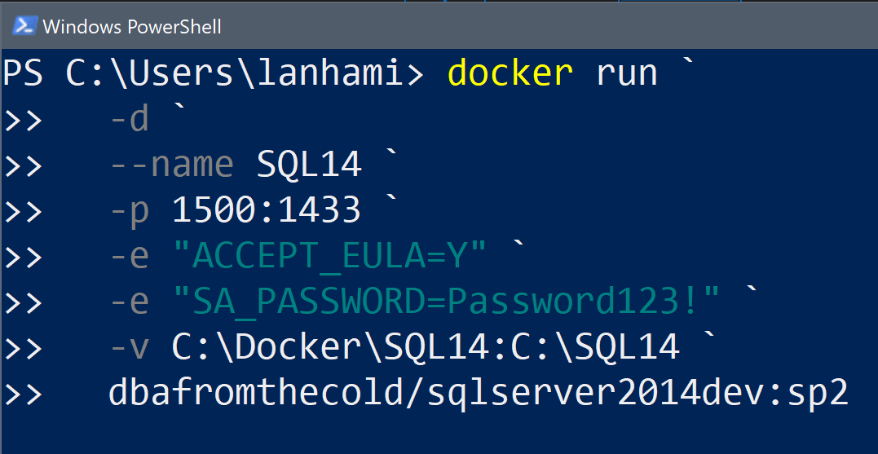
Docker Run Breakdown – Use rest of this slide, combine with command below
Run in Background/as a Daemon
Container Name
Port in my OS:Port inside Container
Environment Variables
Path in my OS:Path inside Container
Image Name to Use:Image Tag
Template source
Additional shameless self promotion
Notes:
Mention –it instead of –d to run interactively in the CLI
If you don’t give the Container a name, you get a hex string
-e will change for each container you run, i.e. SQL Server environment variables != Postgres environment variables
-v is either mounting a named volume or using a bind mount. Be clear that we’ll cover in a bit, but that topic is the key to persisting data with Containers
Go over the tag after the colon and that those are important. Demo leaving the tag off and the Docker engine doesn’t know what to do with it

Slide 10
Docker Run Breakdown
docker run --name SQL22 \
-p 1433:1433 \
-e “ACCEPT_UELA=Y” \
-e “MSSQL_SA_PASSWORD=<secret>” \
-v mssql_data:/var/opt/mssql \
-d \
mcr.microsoft.com/mssql/server:2022-latest
Container Name
Port in my OS:Port inside Container
Environment Variables
Path in my OS:Path inside Container
Run in background/as daemon
Image Name to Use:Image Tag
Template source (Cathrine Wilhelmsen)
Shameless self promotion (my blog)
Notes:
Mention –it instead of –d to run interactively in the CLI
If you don’t give the Container a name, you get a hex string
-e will change for each container you run, i.e. SQL Server environment variables != Postgres environment variables
-v is either mounting a named volume or using a bind mount. Be clear that we’ll cover in a bit, but that topic is the key to persisting data with Containers
Go over the tag after the colon and that those are important. Demo leaving the tag off and the Docker engine doesn’t know what to do with it

Slide 11
Demo #1 – Starting a Container
Start our container (SQL)
Connect with SSMS
Notes:
Docker Run
SSMS or ADS: select @@hostname

Slide 12
Keeping data from your Container
Three ways to transfer data into and out of your running Containers:
docker cp
Bind Mounts
Named Volumes
Heads up: both types are added with the –v flag in the docker run command! Format dictates which type is used
Notes:
If I delete a VM, the VHDX files are still there. But if I store files local to the container filesystem and the container is removed, then my data is gone.

Slide 13
Bind Mount vs Named Volume
Volumes separate the local filesystem path from the logical name of the storage path
Named volumes can use drivers or plugins to go to Azure or S3 storage (to name just a few types)
Bind Mounts make a 1:1 link from local filesystem to the Container’s paths

Slide 14
Bind Mounts and Named Volumes
Guideline: Use named volumes if a bind-mount isn’t required
Create a named volume: docker volume create test_vol
See where the named volume lives on your OS: docker volume inspect test_vol
Notes:
Go to the path of the named volume after creating

Slide 15
Demo #2 – Mounting a Volume
Check our local volume contents
Copy files into the local path
Show the new files visible to the container
Notes:
Copy AW2022LT.bak into container
Restore bak from .sql script
`docker exec –it SQL22 sh`
ls pwd and show contents in /opt/mssql/data
Connect & show database

Slide 16
How do I customize a Docker Container?
A couple of different ways:
Create a post-deployment script (.ps1/.sh/etc)
Usual suggestion: create an Image using a Dockerfile
Notes:
Note that option 1 is the only customization available if the image doesn’t have environment variables exposed/documented

Slide 17
How do we build a Docker Image?
We use a Dockerfile
We’ve been using Andrew Pruski’s (@dbafromthecold) excellent images so far, but I couldn’t find the environment variables to customize
We’ll need to use an official Microsoft image which has some environment variables exposed

Slide 18
Demo #3 – Custom Image with a Dockerfile
We’ll create a Dockerfile based on Image microsoft/mssql-server-windows-developer:2022-latest
We’ll attach a few databases at Container Instance runtime so we don’t need to do so manually
Notes:
1.

Slide 19
Good Info for customizing MSSQL Dockerfiles
SQL Server on Kubernetes – Apress – Anthony Nocentino & Ben Weissman – 2021
Anthony Nocentino has a blog with several articles on Docker too
The SQL Server DBA’s Guide to Docker Containers – Apress – Edwin Sarmiento - 2020

Slide 20
Credits and Acknowledgements
None of this presentation would be possible without two key sources:
Catherine Wilhelmsen (@catherinew)
Her article on Docker is a great way to get started in a short amount of time https://www.cathrinewilhelmsen.net/2018/12/02/sql-server-2019-docker-container/
Andrew Pruski (@dbafromthecold)
His container series is phenomenal https://dbafromthecold.com/2017/03/15/summary-of-my-container-series/

Slide 21


Slide 22

Contact Info
E-mail: ilanham@gmail.com
A copy of this presentation is on GitHub: https://github.com/ilanham/Presentations

